Slide 1




Integrated Pest Management
Dr. Bryan Stevens
8/17/23
11 am to 1 pm

Slide 2
INTRODUCTIONS
Born and raised in Wyoming
Deep appreciation for this world we live on
Non traditional path to where I am today

Slide 3
INTRODUCTIONS
Utah Tech University Natural Science Museum
Collection started in ~1917
Official museum in 1990
Collection contains:
Over 23,000 plants
Over 20,000 insects
Over 3,000 vertebrates
Many live animal ambassadors

Slide 4
INTRODUCTIONS
Website
https://discover.utahtech.edu/

Slide 5
INTRODUCTIONS
Please share the following:
Your name, where you work, and your role
What pests have you encountered
What is typically done for control

Slide 6
GOALS
Key Themes
What is a pest
What is Integrated Pest Management (IPM)
Why IPM and not traditional methods
Doing IPM
Common pests found in museum
Gain a better understanding of Key Themes...

Slide 7

Let’s Get Into It

Slide 8
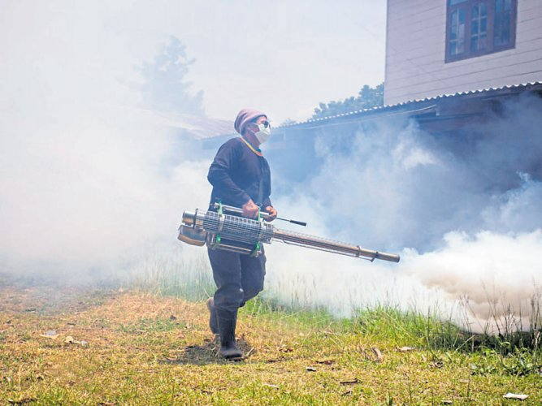
What is a pest?
Any organism(s) that damage, interfere, and/or impact plant, human, or animal health indoors and out.
Examples of pests:

Slide 9
What is Integrated Pest Management (IPM)?
Living organisms compete for 3 things:
Food
Water
Shelter
We humans are great at providing those things
How do we provide these to pests?
Integrated Pest Management (IPM) is a proactive, multi prong, common-sense approach to preventing and controlling pests
Notes:
For a better understanding of a multi prong approach please refer to the IPM pyramid on the next slide.

Slide 10
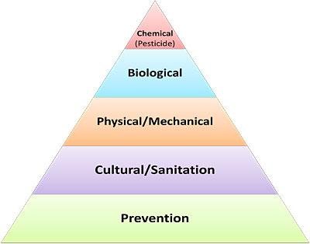
What is Integrated Pest Management (IPM)?
Notes:
IPM starts with prevention, the elimination of and/or access to what the pest is looking (food, water, shelter). What human behaviors (culture/sanitation) can we change to reduce attracting pests. Physically/mechanically remove any pests and signs of their presence and/or change habitat to be less inviting to pests. What stage of growth (Biological) is the pest in and when is the best time to treat for pest. Judiciously use chemicals to reduce an infestation quickly so that the other steps of IPM will be most effective.

Slide 11
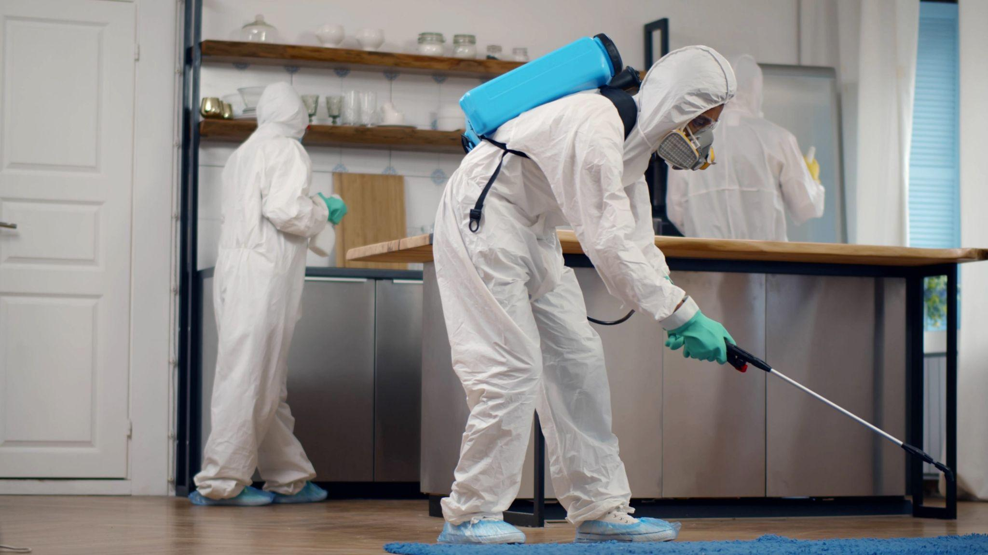
Why IPM?
Solve pest problems while minimizing risk to people and environment
Pesticides may have harmful impacts on humans
Pesticides may kill non-target organisms
Pesticide resistance
Pesticides may contaminate food and water sources
Traditional pest control is a recurring cost
Proper IPM use creates effective long-term control

Slide 12
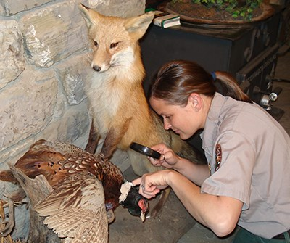
Doing IPM
3 Steps to using IPM
Monitoring
- Daily, weekly, monthly inspections
Logging and Reporting
- Live and dead pests
- Signs of pest presence
- Waste, trails, damage, exoskeletons
Pest removal & prevention

Slide 13
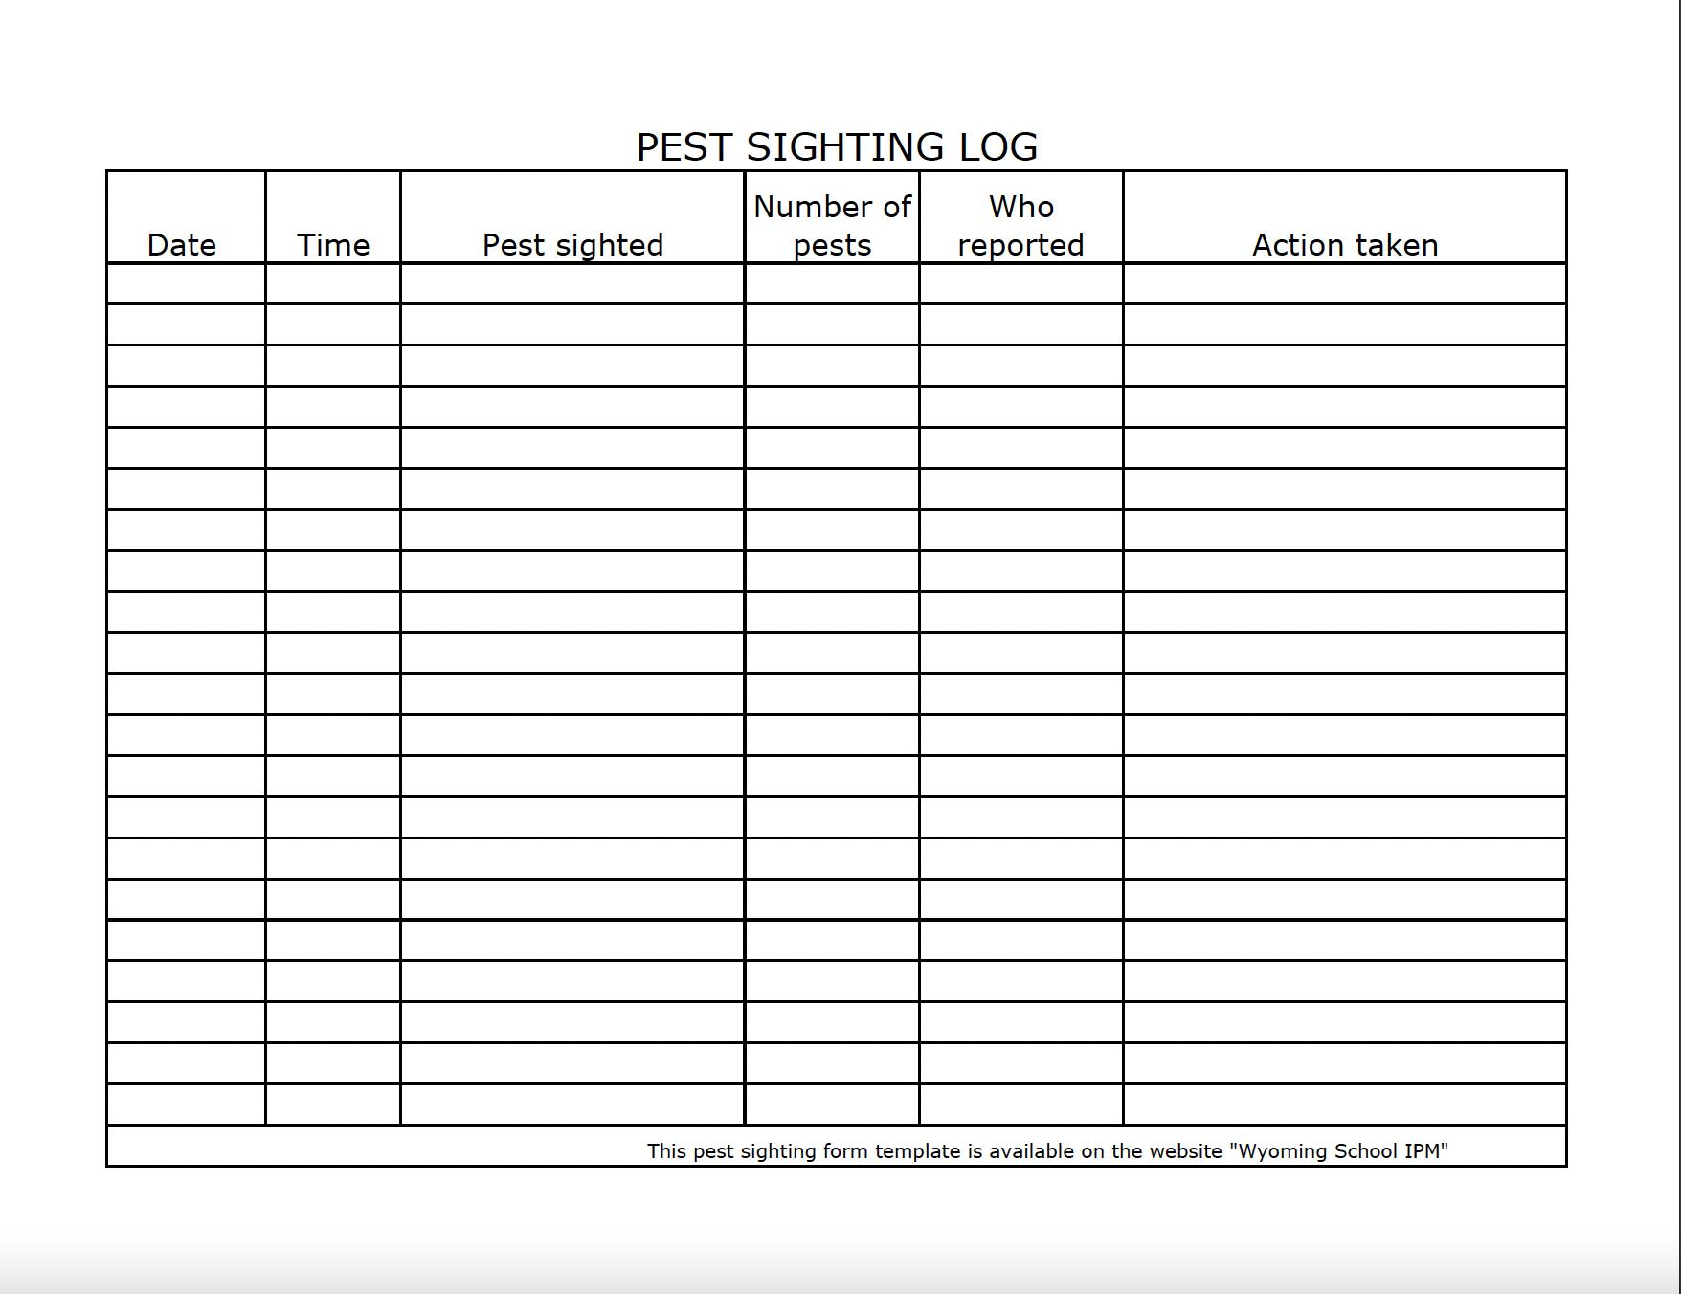
Pest Log

Slide 14
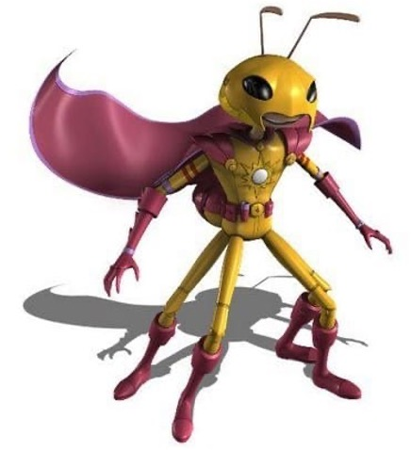
Doing IPM
Tools of the Trade:
-Traps
- Sticky, bait, pheromone
-Door sweeps
-Weather stripping
-Wire mesh
-Steel wool
-Caulk
-Flashlight
-Blacklight
-Extendable mirror with lights
-Knee pads
-Cleaning supplies
-Pesticides

Slide 15
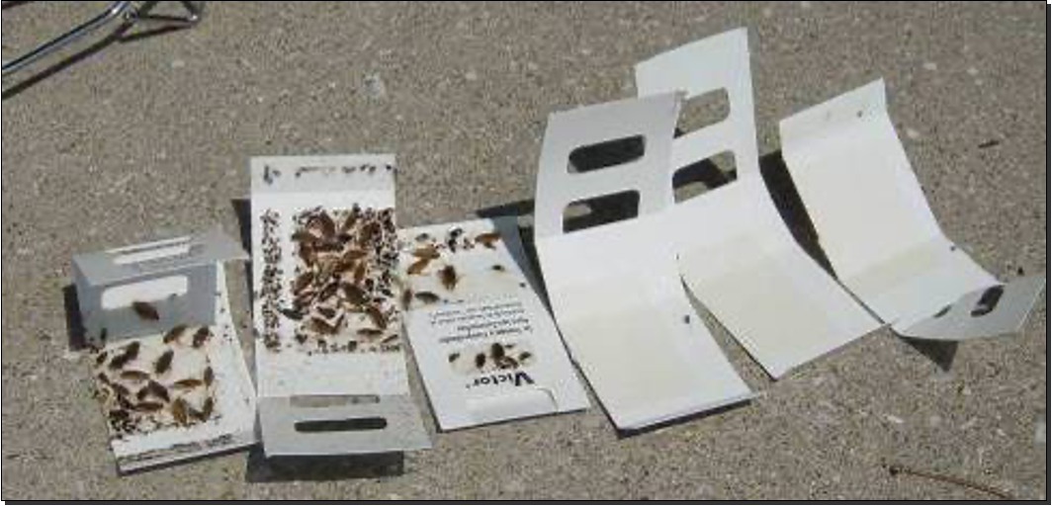
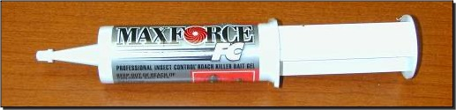
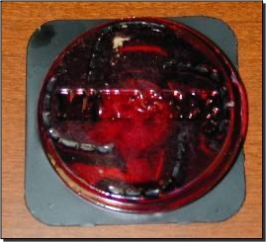
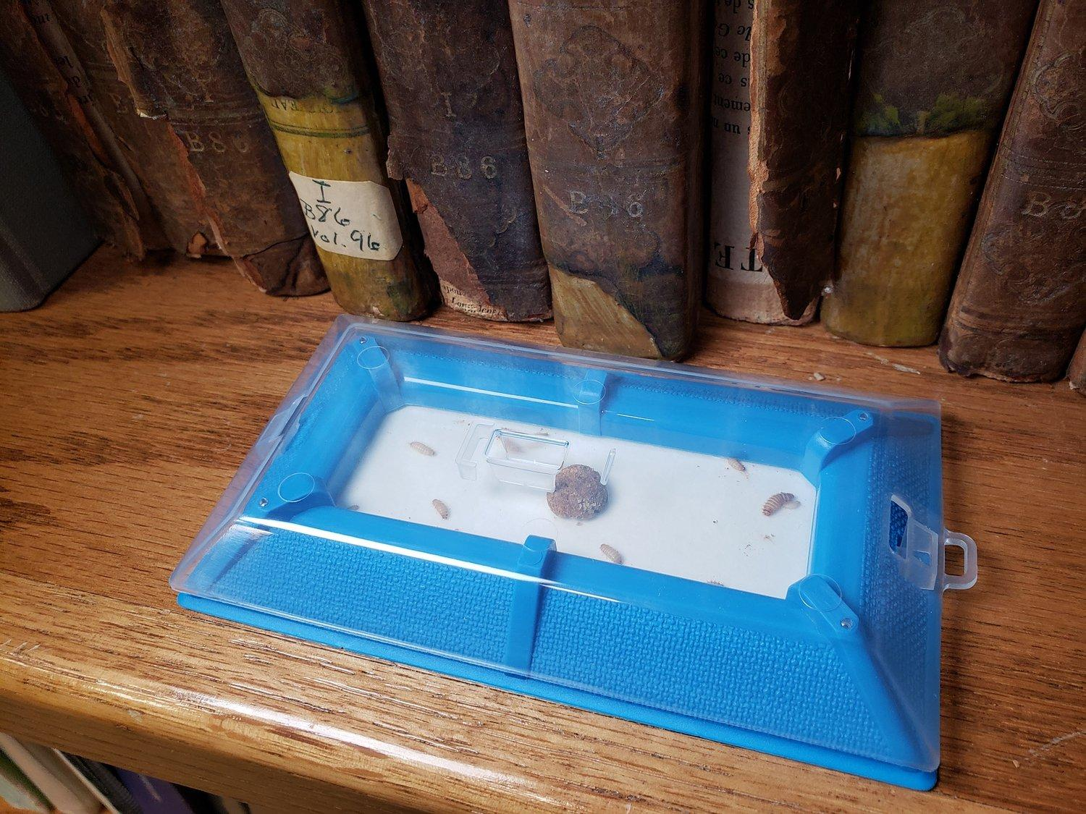
Sticky traps
Baits
Pheromone
Notes:
Use sticky traps to determine presence and location of pest source. With baits, the label is the law, be sure to follow label instructions. Pheromone traps are species specific.

Slide 16
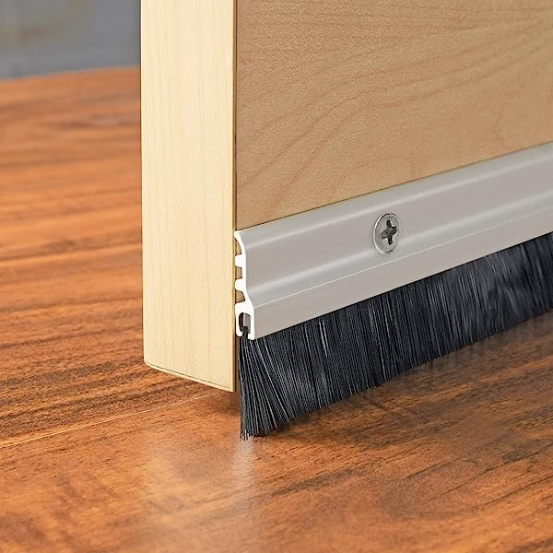
Door sweeps
Notes:
Nylon bristles seem to work best and last the longest.

Slide 17

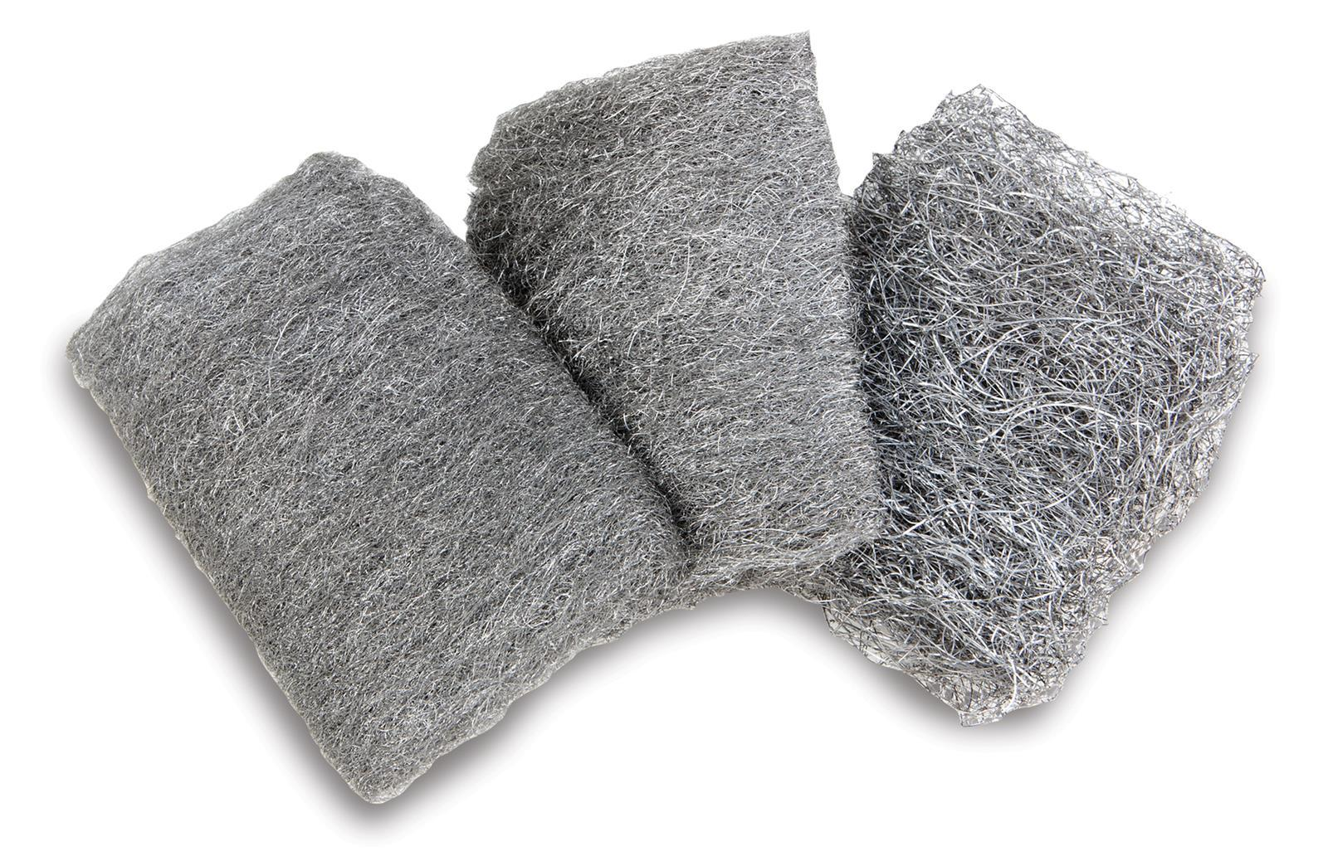
Wire mesh and steel wool
Notes:
Use wire mesh to seal up entrances and exits and steel wool to fill in holes. Pests can’t chew through these.

Slide 18
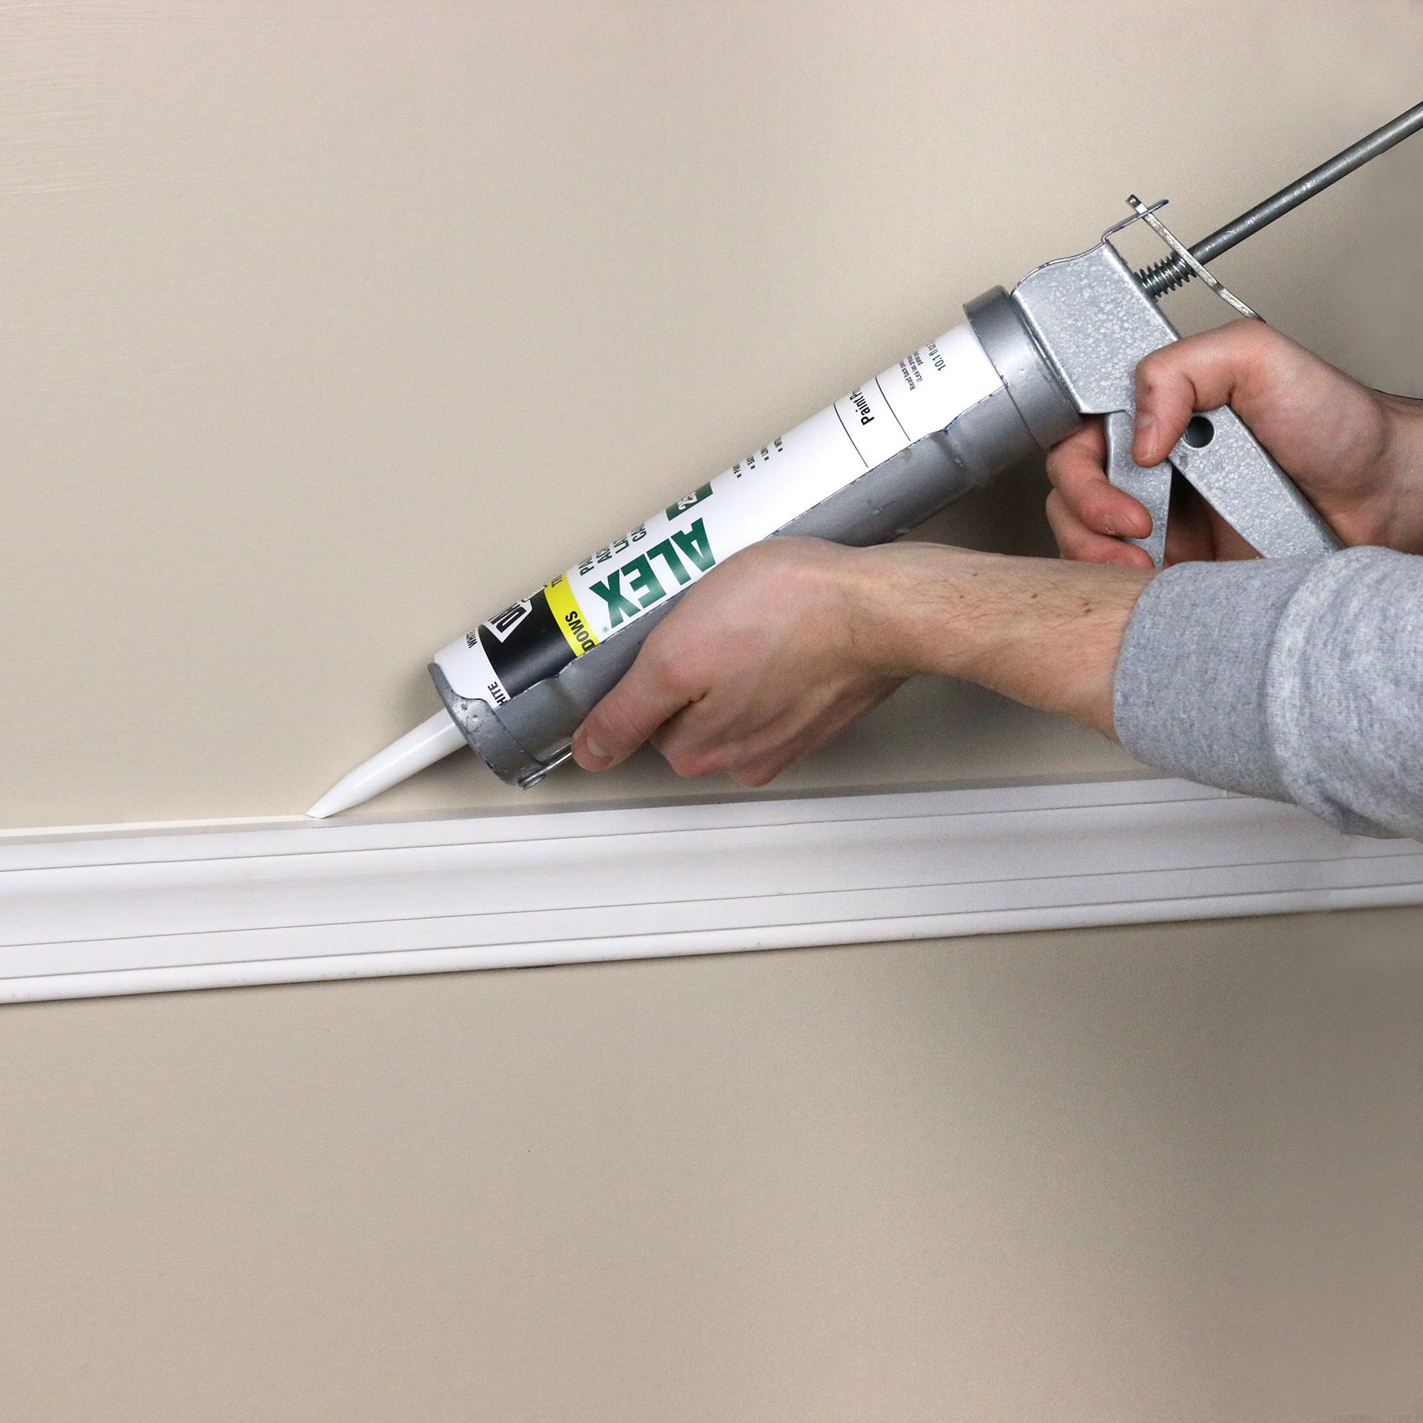
Caulk
Notes:
Great way to seal cracks and crevices.

Slide 19
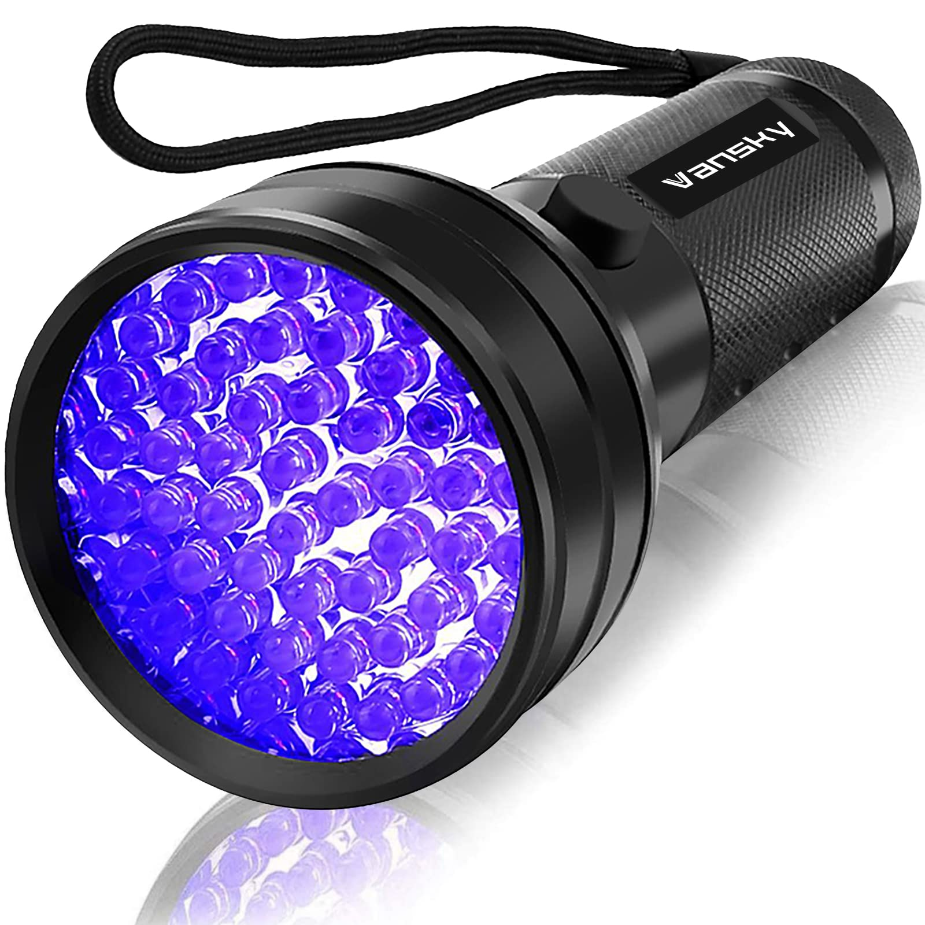
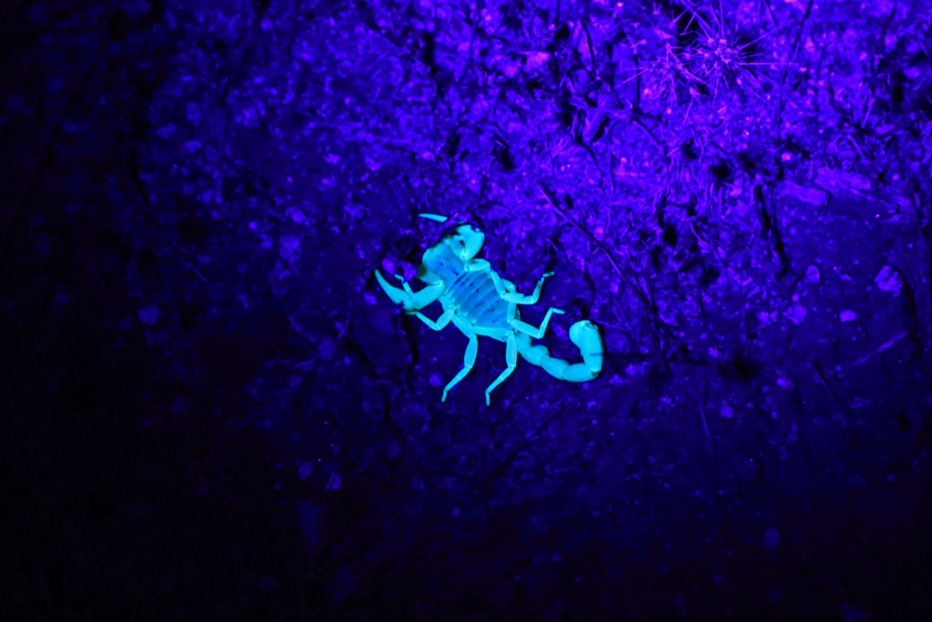
Black lights
Notes:
Rodent urine is visible with a black light. A scorpions exoskeleton will reflect black light making them really stand out.

Slide 20

Extendable mirror with light
Notes:
Extendable mirrors make looking under floor level ledges and into some cracks and crevices easier (not so much getting up and down from the floor). The light will help illuminate into those cracks and crevices.

Slide 21
Tools
Flashlight
Knee pads
Critter catching containers
Cleaning supplies - Label is the law. Always follow label instructions.
Pesticides - Label is the law. Always follow label instructions.
Notes:
Containers can be any container that has a lid. I use old prescription bottles, tupperware, mason jars, etc.

Slide 22

BREAK (10 Minutes)

Slide 23
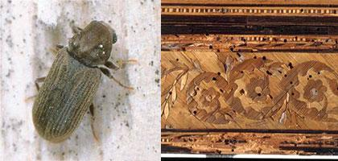
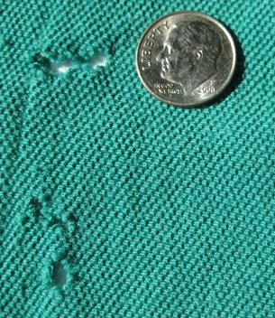
Pest Damage
Dermestid Beetle
Wood Boring Beetle

Slide 24
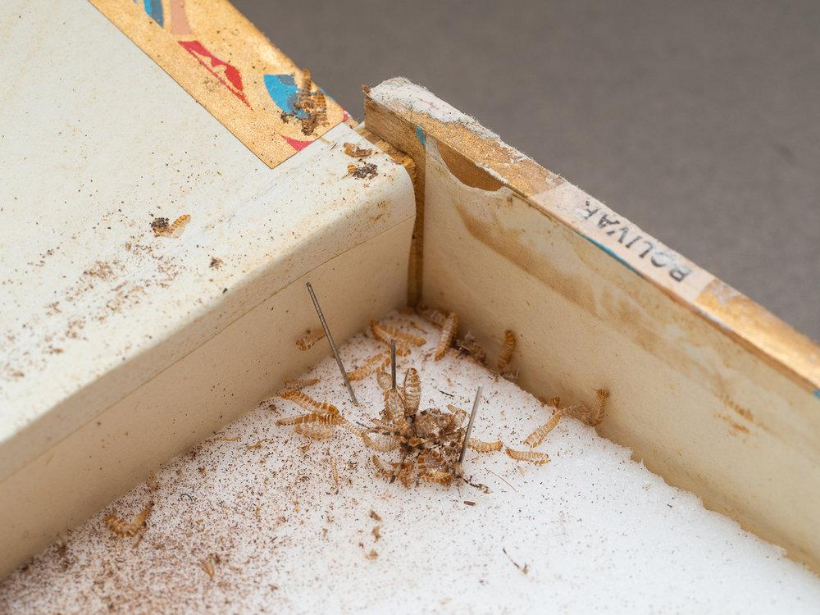
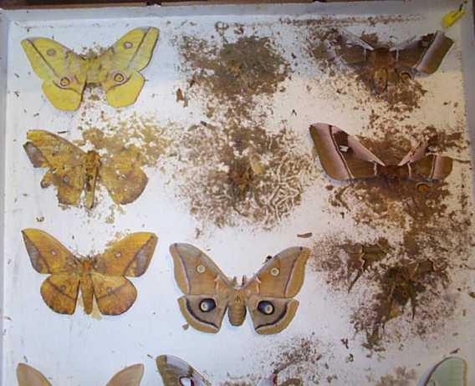
Pest Damage
Dermestid Beetle

Slide 25
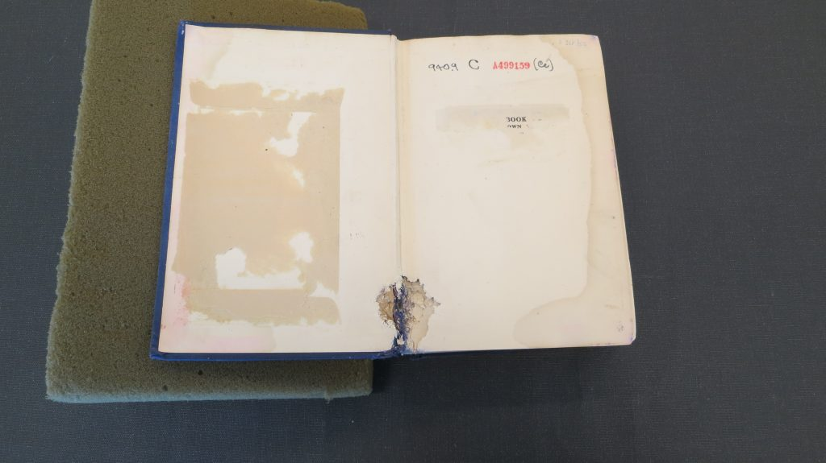
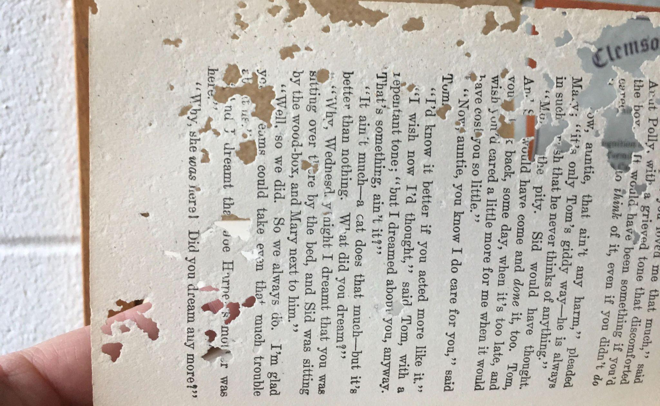
Pest Damage
Silverfish
Dermestid Beetle

Slide 26
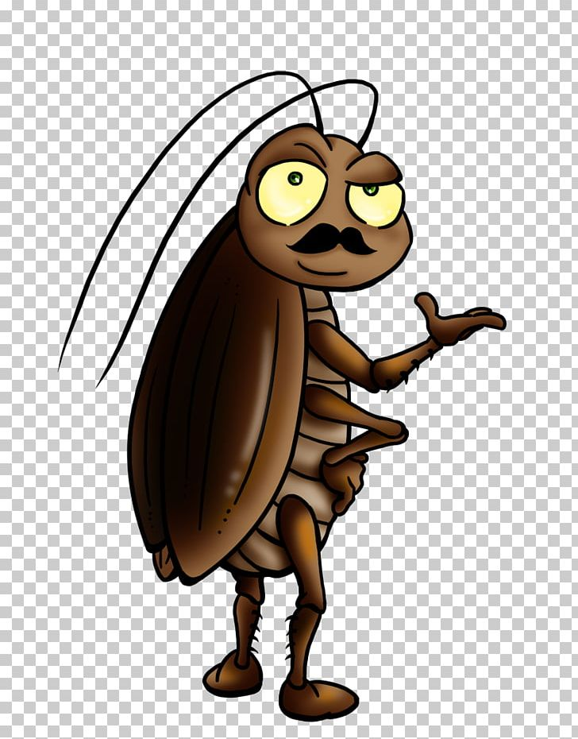
Common Pests
Pests you may encounter:
Damaging pests
  German cockroaches
  Silverfish
  Book lice
  Dermestid beetles
  Mice
Nuisance pests
  Flies
  Birds
  Bats
  Ants
  Outdoor cockroaches (American, Oriental, etc)
  Spiders
  Snakes??
Notes:
An example list of what may enter your museum. However, the basics and standards of IPM can apply to anything you encounter.

Slide 27
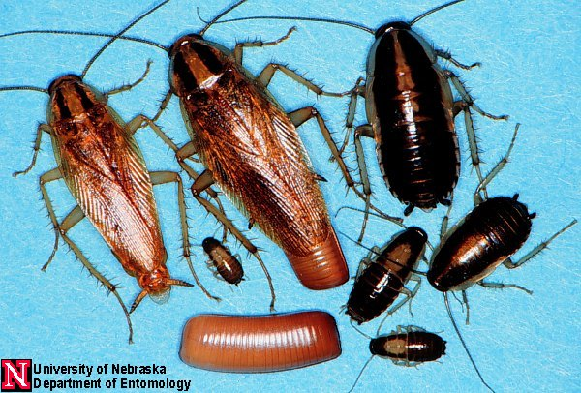
  Let's think like a pest
  Example: German cockroach
Notes:
Image for identification purposes. Note the stripes on the adults to the left. Also an egg sac and immatures.

Slide 28
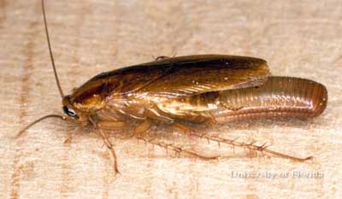
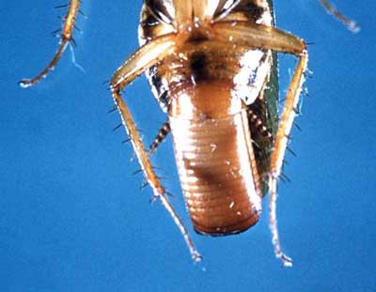
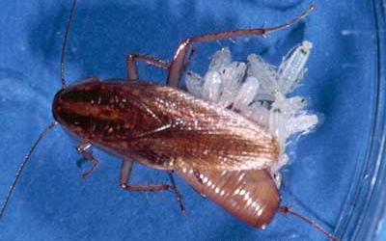
  German cockroach
    Like warm, humid places
    Proliferate in human homes
    Hide out in cracks and crevices close to food and water sources
Notes:
‹#›

Slide 29
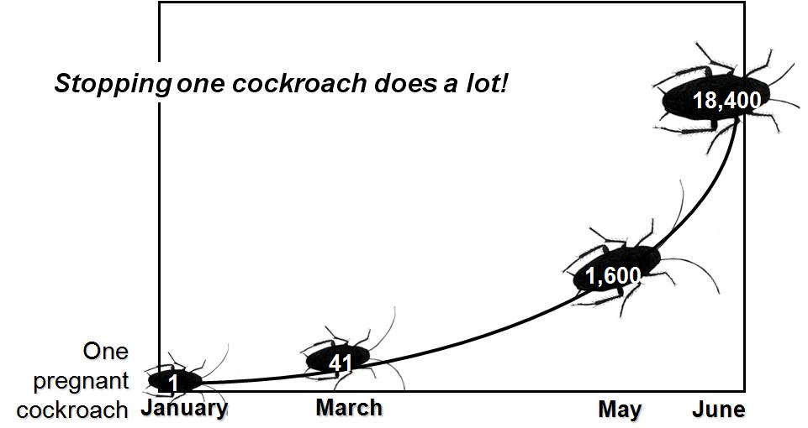
German cockroach
Notes:
‹#›

Slide 30
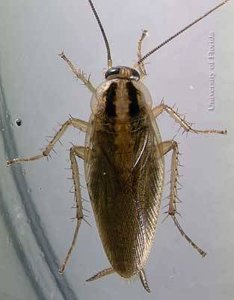
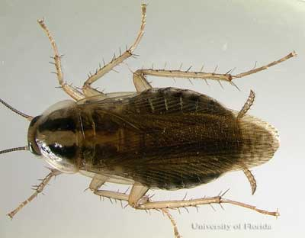
Male
Female
Actively growing populations are 80% nymphs and 20 % adults
The cockroach is omnivorous, eating table scraps, pet food, book bindings, dead cockroaches.
Notes:
‹#›

Slide 31
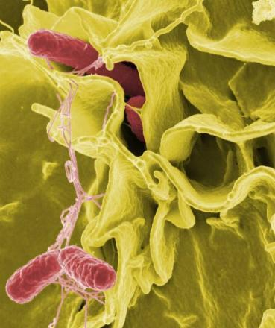
  Blattella germanica (German cockroach)
    Salmonella remains viable in the digestive tract of German roaches for 9 days and on the exoskeleton for 10 days
        Proteus mirabilis, Pseudomonas aeruginosa, Salmonella spp., Serratia marcescens, Shingella, Enterobius vermicularis (pinworm), Trichuris trichura (threadworm), Entamoeba hystolytica (amoebic dysentery), Gardia sp. Poliomyelitis (paralytic polio).
Notes:
‹#›

Slide 32
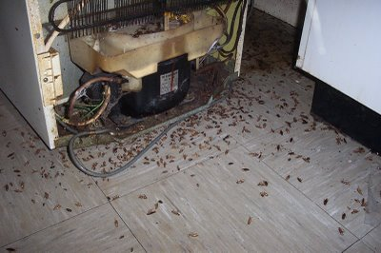
German cockroach & asthma
Cockroaches are a leading cause of childhood asthma
An inner-city
study found
36.8% of
children are
allergic to
cockroach
allergens
Notes:
‹#›

Slide 33
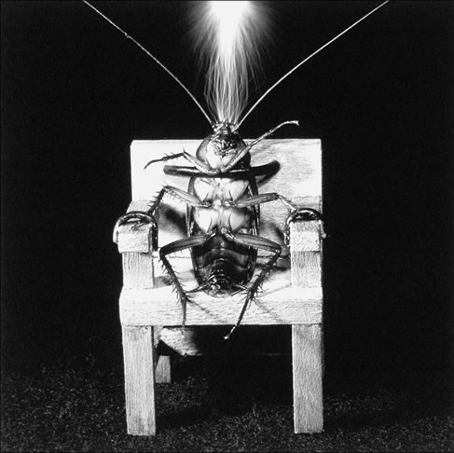
So how
do we control
them?
Notes:
‹#›

Slide 34
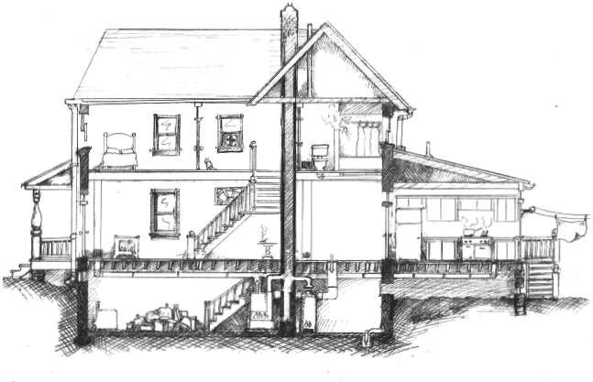
Think like a cockroach/pest
Notes:
‹#›
Macro vs micro thinking. Macro thinking is only looking at the large spaces in the house. A pest uses micro thinking….inside a toaster, behind a clock, in between walls, etc.

Slide 35
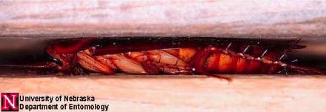
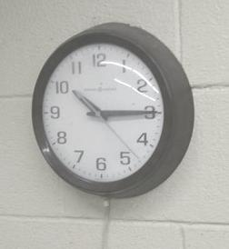
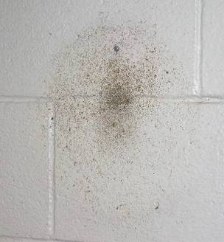
Get rid of:
Cockroaches,frass (insect poop), dead bodies and shed exoskeletons, allergens.
Behind the wall clock
Notes:
‹#›

Slide 36

Now that we can think like a pest, let's look at a few and discuss how best to approach the situation
Notes:
‹#›

Slide 37
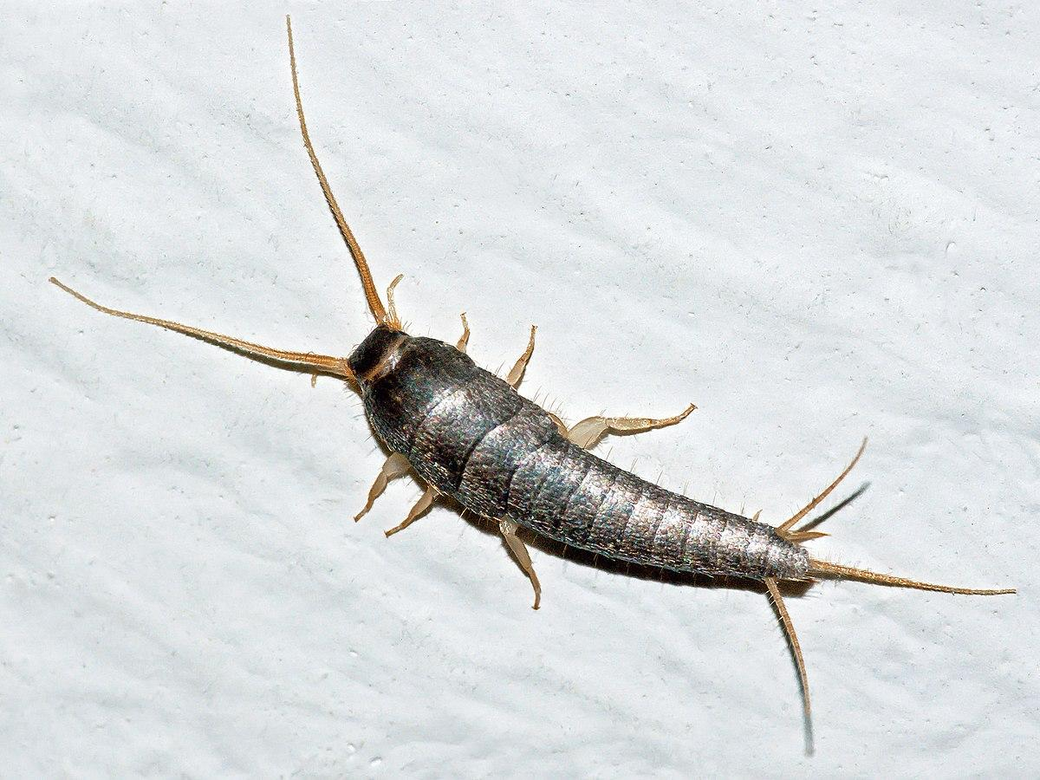
Silverfish
Feeds on paper, glue/paste in book bindings, dead insects
Requires moisture, heat, and food
What are some IPM measures to control?

Slide 38
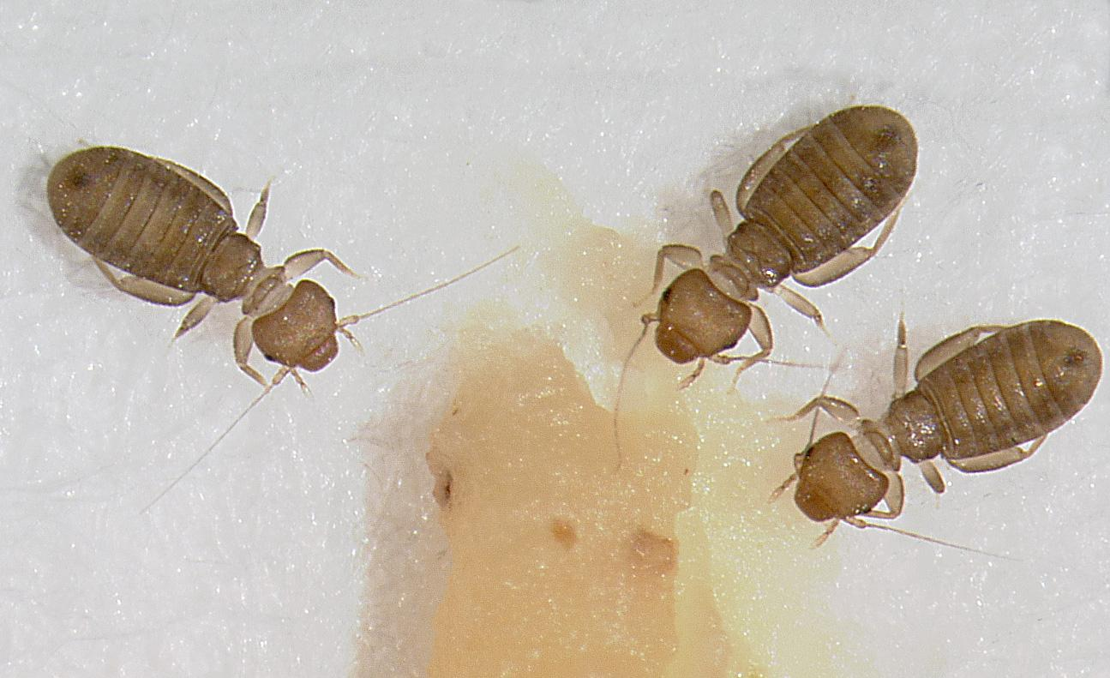
Book lice
Warm, humid/damp spaces
Often found in books and cardboard
Consume mold, mold spores, and paper products
What are some IPM measures to control?

Slide 39
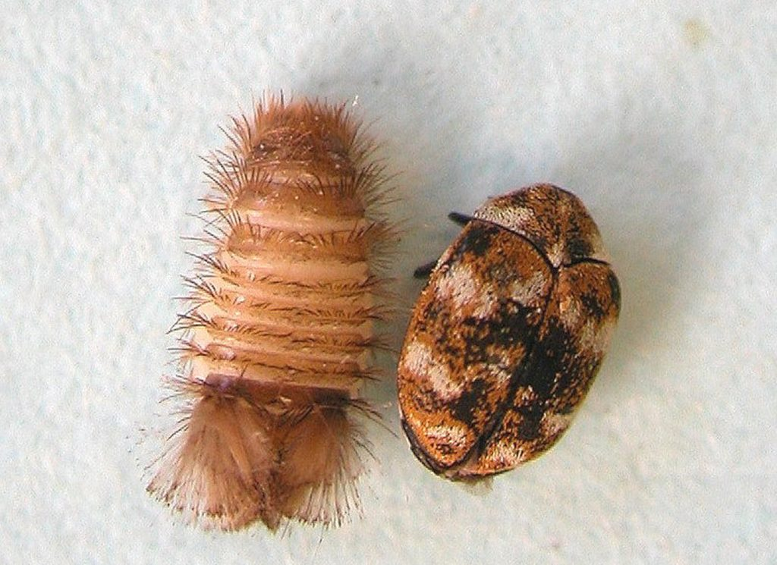
Dermestid beetles
Multiple species may be found
Depending on species they’ll damage fabrics, furniture, dry foods, animal hides, fur, feathers, leather, preserved insects
May be used by museums to clean tissue off of animal bones
What are some IPM measures to control?
Notes:
Of the multiple species the immatures/larvae (on the left) look fairly similar with light brown tubular bodies and rows of hairs. Adults (on the right) are very small to small and vary in color from dark brown to multi-colored.

Slide 40
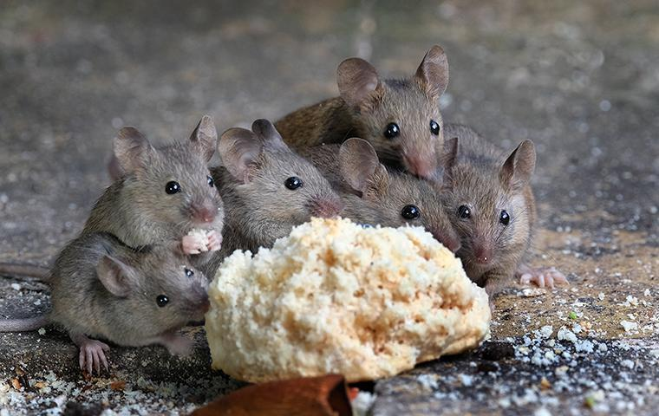
Mice/Rats
Damages through eating, waste accumulation, nesting activities, may spread disease
Reproduce quickly, fit in very small spaces, eat or chew on most things
Can be difficult to control
What are some IPM measures to control?

Slide 41
Some “pests” don’t pose a direct threat to our collections
What are some “pests” that we may encounter in or near our museums that don’t pose a direct threat to our collections???
Hints:
They may cause damage to our buildings or if they get into our museums when trying to escape or while being captured
They may cause problems while we are trying to access our museums
They may be a health hazard inside and out

Slide 42
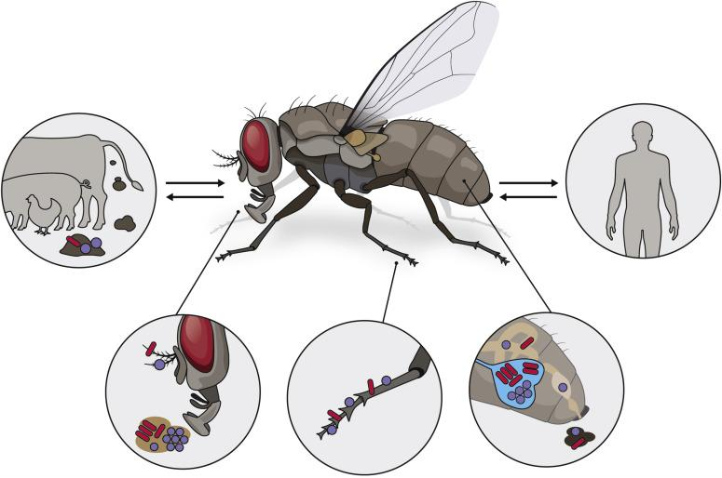
Flies
Why manage for flies:
Annoying
Illness and disease through contact
May over winter in warmer parts of building and become active during winter warm spells
Management???

Slide 43
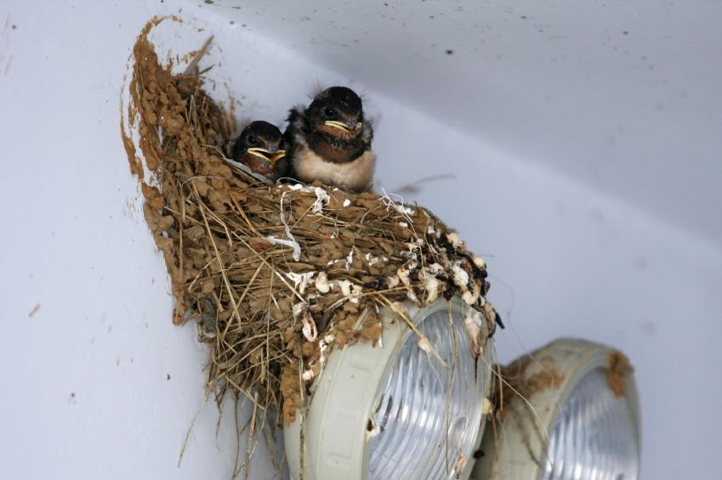
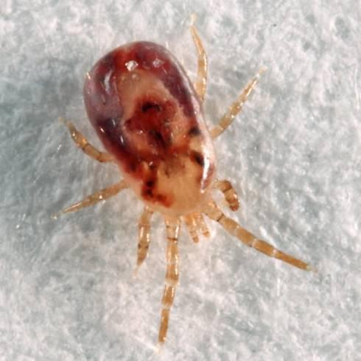
Birds
We love birds!!!! Except when they live and visit where they shouldn’t!!
Messy
Spread disease
Noisy
Bird mites - feed on bird blood, may try to feed on people
Management Ideas?

Slide 44
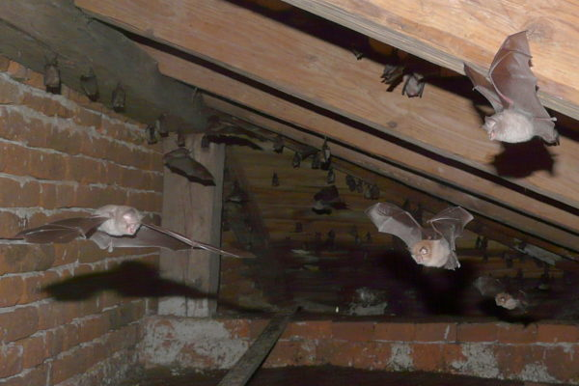
Bats
BATS ARE PROTECTED…DO NOT KILL!!!!
May harbor disease like rabies
May like our buildings for nesting and overwintering sites
May accidentally come in through vents or open windows
Contact Division of Wildlife Resources and/or pest control for safe removal
If nesting in building use a professional to remove when legal and then seal up entrance/exits of nest

Slide 45
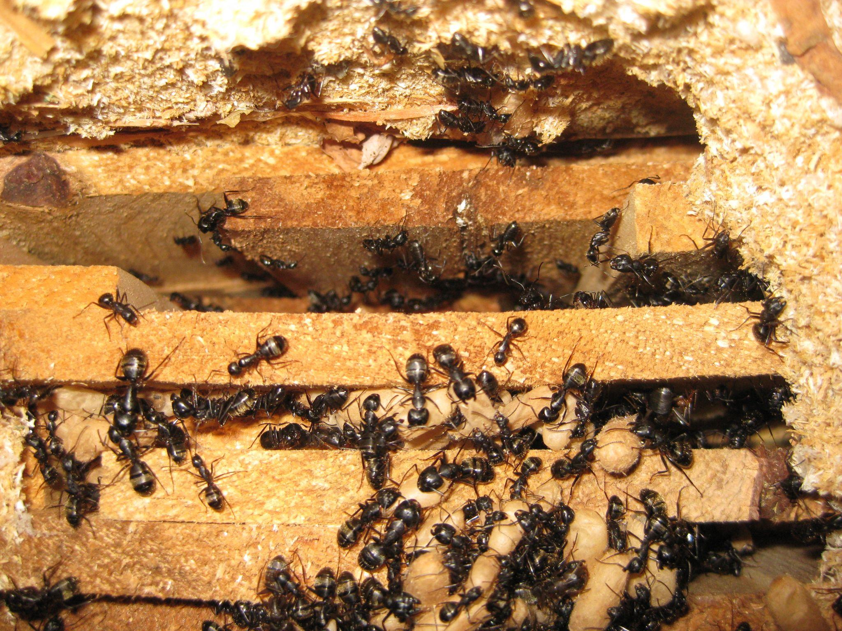
Ants
Depending on species may cause damage or only be nuisance.
Important to identify species to determine if it can damage structures
Other ant species are a nuisance
Have nothing better to do than look for food, water, shelter!!!
How do ants follow trails?
Management ideas?
Notes:
Carpenter ants will build nests in our wood products. A pest control specialist is best approach to removal. Other ants are looking for food, water, and shelter. Remove access to these, sanitize, and seal cracks and crevices.

Slide 46
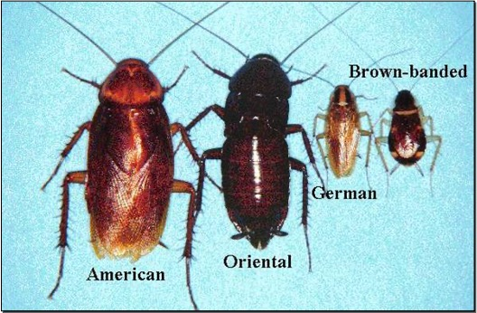
Non German Cockroaches
Notes:
American, Oriental, and other outdoor cockroaches find their way into our space. They do not necessarily want to be there just can’t find their way back out. Exclusion is best approach.

Slide 47
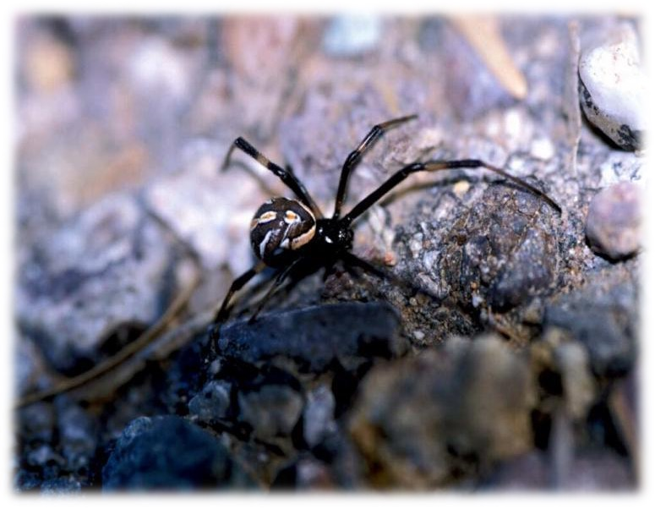
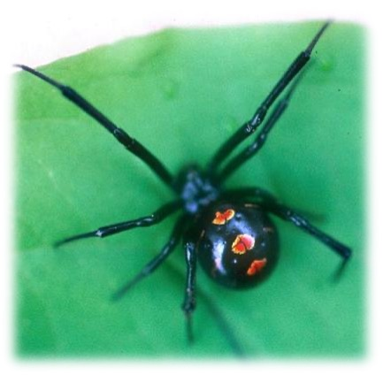
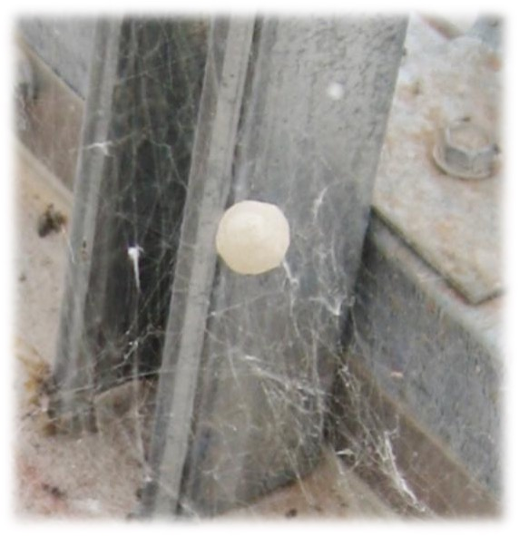
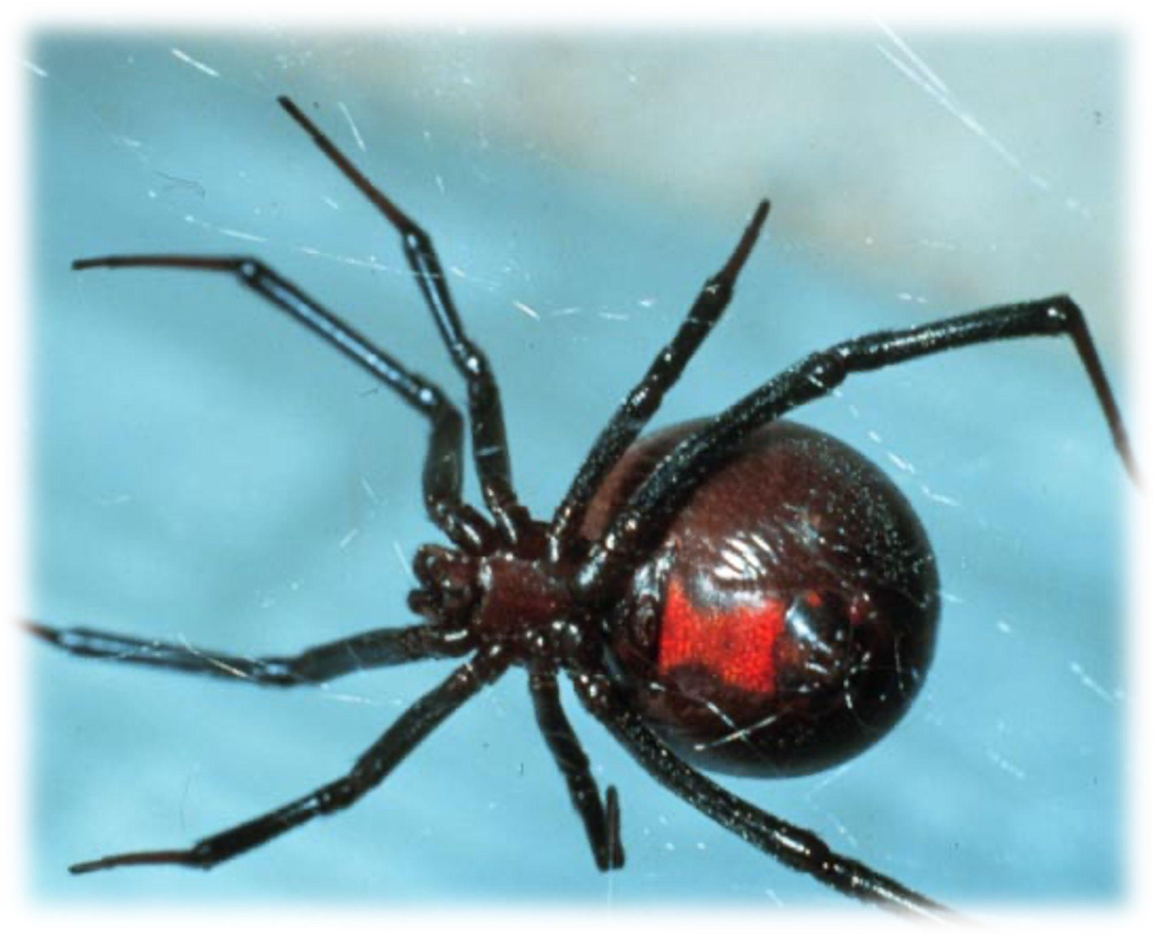
Spiders
Notes:
You may encounter all sorts of spiders and other than the black widow, most are fairly harmless. Making sure to declutter and seal up cracks and crevices goes a long way in preventing spiders from entering our space. You can use a container to capture and move outside, vacuum up adults and webs, smash if you have to but they are important members of our environment.

Slide 48


Spiders
Hobo spider
Cellar spider
Notes:
Two common spiders that we may find. Follow standard IPM measures (learned above) to manage.

Slide 49

Miscellaneous
Random “intruders/invaders/squatters”:
Small birds
Squirrels
Snakes
To prevent random intruders of the pest kind, make sure windows have intact screens, doors have functioning door sweeps, cracks and crevices are sealed
Always contact a professional if you are not able to safely capture and release

Slide 50

ReCap
What is a pest?
What is IPM?
Why IPM over traditional pest management?

Slide 51
Sources
Utah State University Extension
University of Wyoming Extension
Dawn Gouge, University of Arizona
United States Environmental Protection Agency
Lots and lots of schooling

Slide 52

Questions?

Slide 53



Thank you!
Bryan Stevens | bryan.stevens@utahtech.edu
https://artsandmuseums.utah.gov/utah-collections-preservation/
This project was made possible in part by the National Endowment for the Humanities.

